Slide 1


Fake News Detection Machine Learning with NLP
This presentation outlines a machine learning project aimed at detecting fake news, discussing the dataset used, preprocessing steps, and model implementation.
by Sankari C

Slide 2
Understanding the Dataset
The dataset comprises five columns: ID, Title, Author, Text, and Label. ID is a unique identifier for each news article. Title represents the news article's title, Author identifies the article's writer, Text holds the article's content, and Label indicates whether the news is real (0) or fake (1).
The dataset is essential for training the machine learning model. It provides a rich collection of labeled news articles, allowing the model to learn patterns associated with genuine and fabricated news. The project utilizes this data to build a robust fake news detection system.

Slide 3
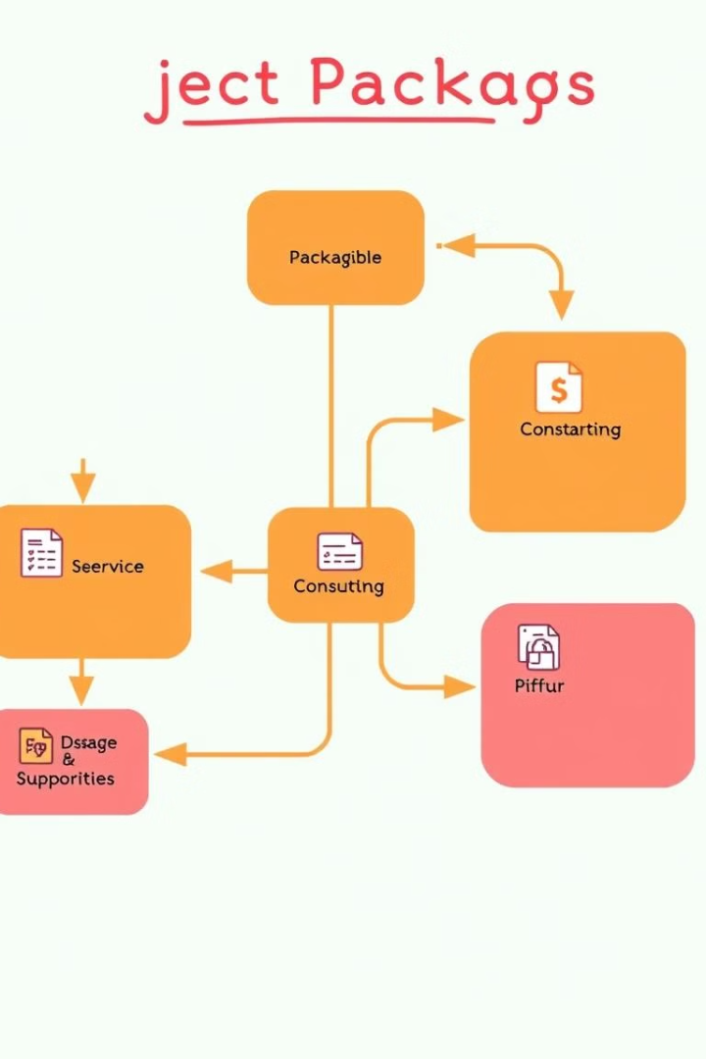
Essential Packages and Their Roles
Pandas
Used to create dataframes for data manipulation and analysis, facilitating efficient handling of the news dataset.
NumPy
Provides support for creating and manipulating multidimensional arrays, crucial for numerical computations and vectorizing textual data.
Regular Expressions (Re)
Enables searching for specific patterns within the text data, aiding in preprocessing steps such as removing non-alphabetical characters.
NLTK
A powerful toolkit for natural language processing, offering functionalities for text preprocessing, stemming, and tokenization.

Slide 4
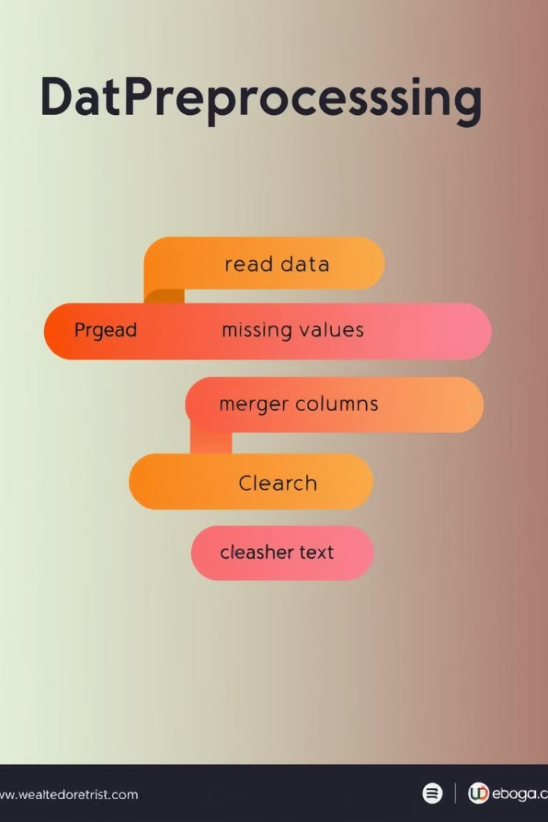
Data Preprocessing: Preparing the Data
1
The first step involves reading the dataset into a Pandas dataframe, providing a structured representation of the data.
2
Next, we analyze the data for missing values, identifying instances where information is incomplete. These missing values are then filled with empty strings, ensuring consistent data format.
3
The title and author columns are then combined. The text column already contains enough information for prediction, so merging these columns is not essential for this project.

Slide 5

Stemming: Extracting Root Words
1
Stemming is a crucial part of natural language processing, aiming to reduce words to their root form.
2
The stemming function removes non-alphabetical characters, converts text to lowercase, and tokenizes the words.
3
Stemming is then applied to the content column of the news dataset, simplifying the text while preserving its core meaning.

Slide 6
Data Transformation: From Text to Numbers
The textual data is converted into numerical form using a vectorizer, enabling machine learning algorithms to process and understand the data.
This process involves representing words as numerical vectors, allowing the model to identify relationships between words and their contexts.

Slide 7




Training and Testing the Model
The dataset is divided into training and testing sets. The training set is used to train the model, allowing it to learn the patterns associated with fake news.
The testing set is used to evaluate the model's performance on unseen data, providing a measure of its ability to generalize and predict accurately.
A Logistic Regression model is employed to predict the label of a news article based on its content.

Slide 8

Model Evaluation and Deployment
The accuracy score is calculated for both the training and testing sets, providing insights into the model's effectiveness.
The model's accuracy reflects its ability to correctly classify news articles as real or fake.
Once the model is deemed satisfactory, a prediction system is implemented to allow users to input news articles and receive a prediction of their authenticity.

